Slide 1

Alliance Data: Mobile Labor Statistics App
Team 2

Slide 2



Roles
Team Lead: Catherine Jojo
Requirements Lead: Azeem Ali
Architecture Lead: Christie Baker
Development Lead: James Ballard
Testing Lead: Mehmet Ekizoglu

Slide 3

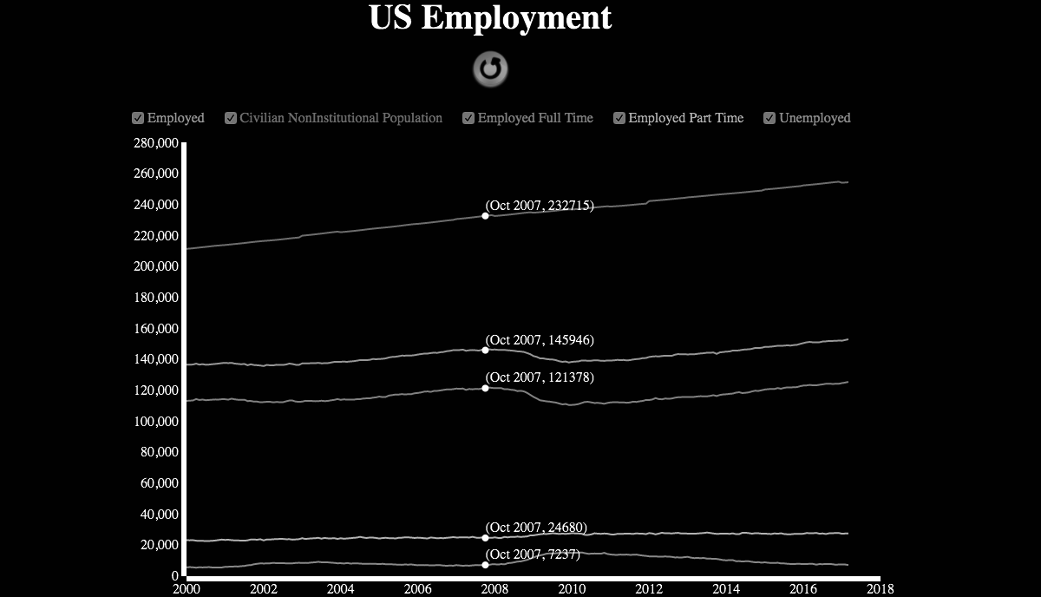


Development Teams
Front End
Azeem Ali
Christie Baker
Back End
James Ballard
Mehmet Ekizoglu
Catherine Jojo

Slide 4
Objective and Scope of Project
Objective: To provide a web application to Alliance Data that efficiently gathers and displays data various data sets from the Bureau of Labor Statistics website in a single interface.
Scope: Create a user friendly interface to fetch Labor Statistics by relevant groupings. Data is displayed in both a graphical and table format and is readily available to be transferred. The site is accessible through mobile and desktop browsers.
Notes:
//Mehmet
In order to assist with executive presentations in Alliance data, we developed a web application that can function across both desktop and mobile platforms.
The purpose of this web application is to efficiently gather and display various data sets from the Bureau of Labor Statistics website in a single interface.
The data obtained is displayed in both graphical and table format and is readily available to be transferred easily or in other words copied from the website onto a different source.

Slide 5




Surprises
> Gathering data from Labor Statistics websites
> Different browsers behave differently
> Subject matter experts are important
Notes:
//Christie

Slide 6
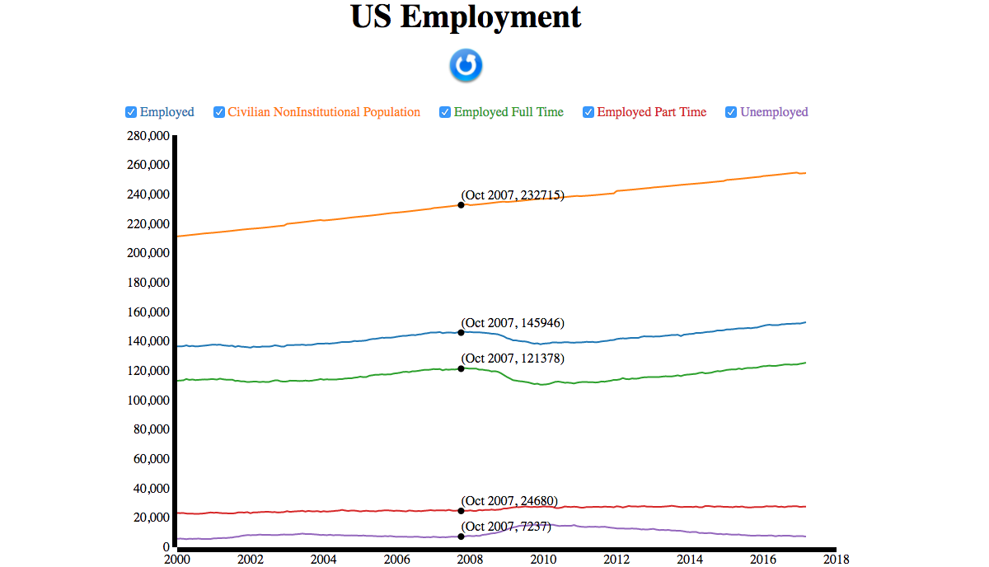


Description of Approach
View
HTML,CSS
MVC Architecture
Model
SQL Database
Controller
Javascript, Servlet

Slide 7

Final Deliverables
Source code
README instructions
Jar file
War file
Final Documentation
Notes:
//Scotty

Slide 8


Lessons Learned
Pros
Divide and Conquer works
Early planning pays off in the end
Communication
Cons
More people more schedule conflicts
Browser Compatibility
Workstation consistency
Notes:
//Azeem

Slide 9

Comments and Suggestions
-Learning new technologies
-Spend more time on architectural and design decisions
-Take a more iterative approach with all phases
Notes:
//Catherine

Slide 10
DEMO
Notes:
//Scotty

Slide 11
Questions?

